Slide 1




Data-Limited Fisheries Toolkit
Evaluating management strategies for data-limited fish species
Specifying MPs and other MSE outputs
Lecture 3b, May 2017
Tom Carruthers & Adrian Hordyk .
Nicolas Gutierrez

Slide 2
Agenda
Specifying MPs for MSE
Convergence diagnostics
Value of information (VOI) analysis
Cost of current uncertainties

Slide 3
Specifying MPs for MSE analysis
DLMtool contains two types of MP that provide different types of management recommendation:
Output control MPs (class Output)
Provide a Total Allowable Catch (TAC), e.g. 100,000 tonnes
2. Input control MPs (class Input)
These MPs control the extent of fishing pressure rather than the
amount of fish extracted and can make recommendations in terms of
- Total Allowable Effort (TAE), e.g. 10,000 days of fishing
- Spatial closures (e.g. no take areas)
- Size limits (e.g. only retain fish over 50cm)

Slide 4

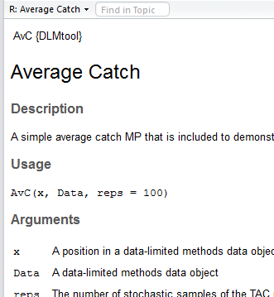
Finding DLMtool MPs
Similarly to other objects in DLMtool you can use the avail()
function to list those that are available:

Slide 5

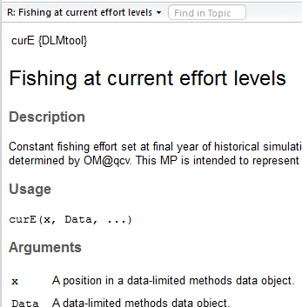
Finding DLMtool MPs
Now for input control MPs

Slide 6
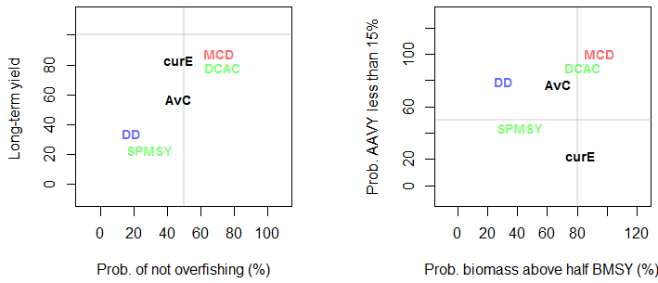
Using selected MPs in an MSE
To evaluate the performance of a set of selected MPs,
you can make a list of their names in R and pass this to the
runMSE() function:
myMPs = c("AvC", "curE", "DCAC", "DD", "MCD", "SPMSY")
myMSE = runMSE(myOM, myMPs)
NOAA_plot(myMSE)

Slide 7
Checking Convergence
By default operating models are run for 48 simulations.
That doesn’t sound like a lot, but how many is enough?
You can check to see whether MP performance is stable using the function Converge()
Converge(myMSE)
This function returns two plots:

Slide 8
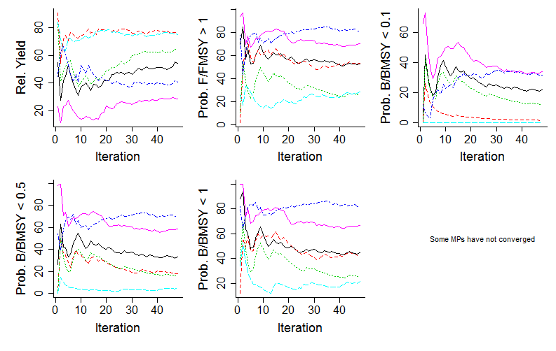
The first plot has 5 panels, each one shows the mean performance of a different metric (y axes) as simulations are added (iterations – the x axis)

Slide 9
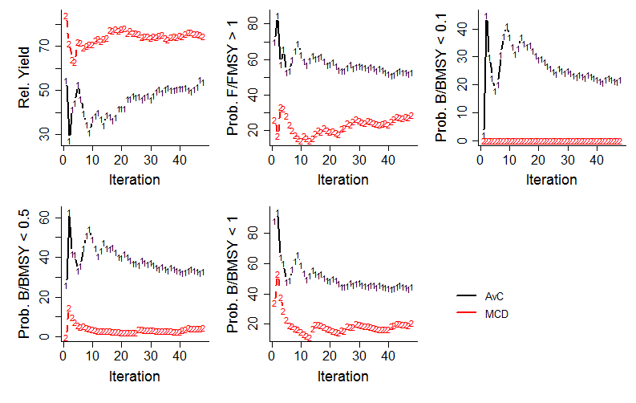
The first plot has noted that some MPs did not converge with respect to 1 or more performance metrics. The second plot (if applicable) highlights these MPs:

Slide 10
Value of information analysis
If we can calculate
- performance for every simulation
and we can track
the conditions of every simulation,
we can analyse which data observation processes are driving performance.
Value of information analysis can identify which data are the most important in successful management.
For any MSE object in DLMtool you can conduct VOI analysis using the VOI() function…

Slide 11
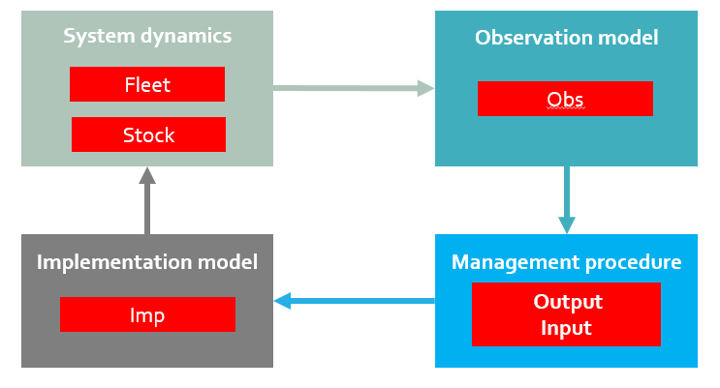
Four of these items are the objects we used to build an operating model
Fleet, Stock, Obs and Imp Objects all contain ‘slots’ that
Define the various aspects of the operating model .
These objects and their slots are all ‘glued’ together in an operating model, allowing for customizability.
You can see what these look like by typing the name of one into
R…

Slide 12
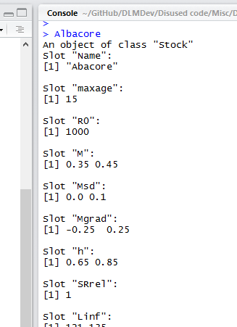
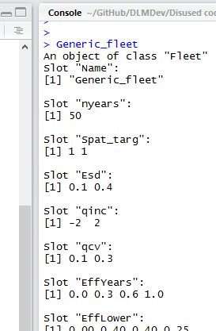
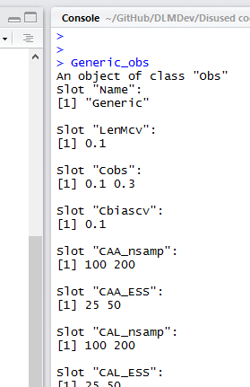
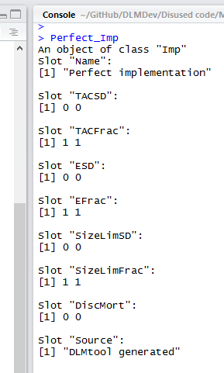
Here is what these objects look like in R:
Stock object
Fleet object
Obs object
Imp object

Slide 13
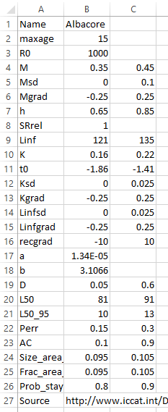
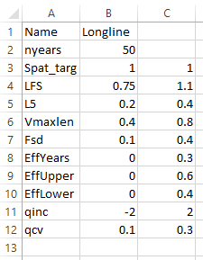
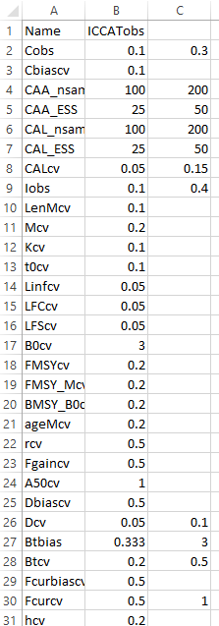
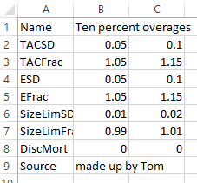
Alternatively each object can be specified in a CSV file:
Stock object
Fleet object
Obs object
Imp object

Slide 14
CSV files can be handy and are easy to import into DLMtool:
Albacore = new(‘Stock’, ’C:/mydata/Albacore.csv’)
Longline = new(‘Fleet’, ‘C:/mydata/Longline.csv’)
ICCATobs = new(‘Obs’, ‘C:/mydata/ICCATobs.csv’)
Overages = new(‘Imp’, ‘C:/mydata/Overages.csv’)
myOM = new(‘OM’, Albacore,
Longline,
ICCATobs,
Overages)
Once imported these objects can be combined in an Operating model:

Slide 15
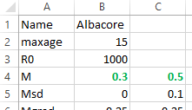
Changing inputs is simple in the CSV:
It is also straightforward in R:
Albacore@M = c(0.3, 0.5)

Slide 16
Getting help with objects
Cheat sheets for objects: /Help/Cheat sheets/
User manual: /Help/DLMtool 4 User Guide.pdf
R package help: class?Stock
class?Fleet
class?Obs
class?Imp
class?OM

